Slide 1
Offer
Type
periode
Product
Id
(rating_id)
@OneToOne(cascade = CascadeType.ALL)
@JoinColumn (name="rating_id", referencedColumnName="id")
Product_Recipe
Recipe
Rating

Slide 2
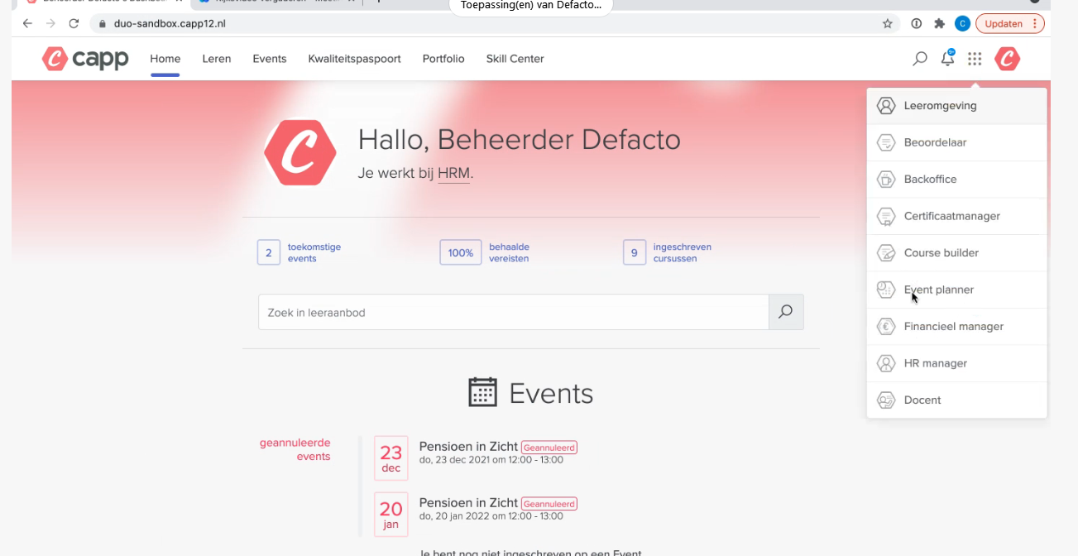

Slide 3
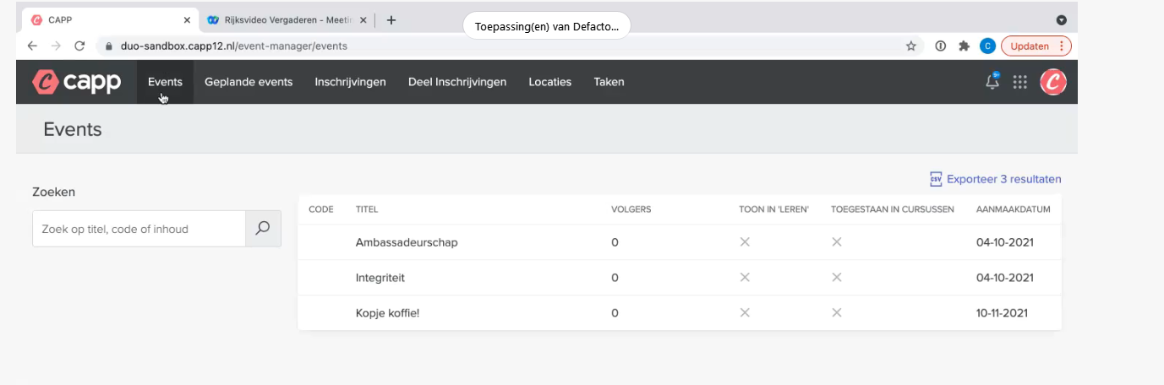

Slide 4
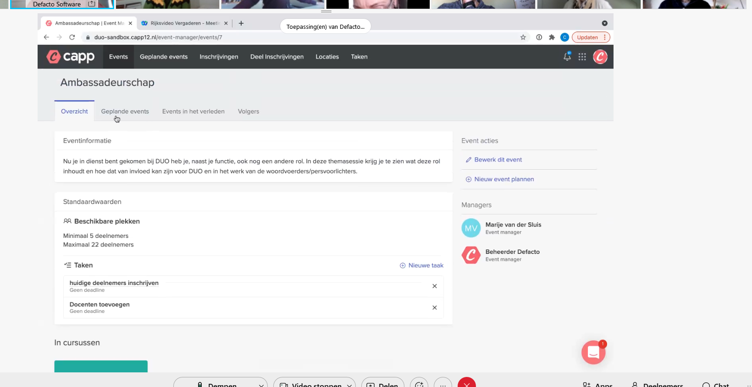

Slide 5
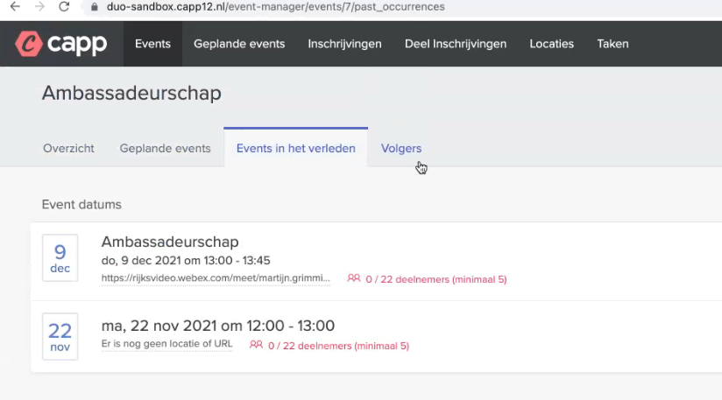
Volgers: hebben bv. de trainingen gemist en hebben belangstellling

Slide 6
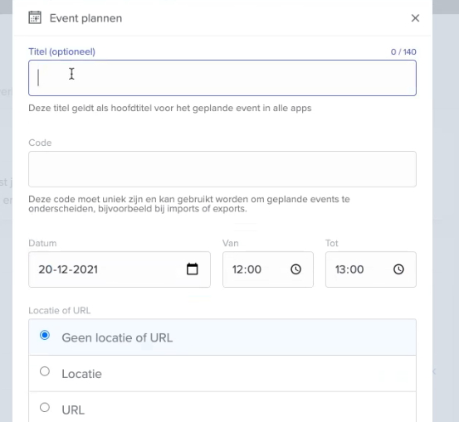

Slide 7
